Slide 1
Table of contents
Feature importance and explanation outcomes
Figure / table | Slide
Feature Importance: SHAP and Permutation Importance | 4
Explanation Evaluation: Grade Scale and Rubrics | 5
GPT Fully Guided: Explanation Outcome Summary | 6
GPT with Some Context: Explanation Outcome Summary | 7
Qwen with Minimal Context: Explanation Outcome Summary | 8
GPT with Minimal Context: Explanation Outcome Summary | 9
Feature Contributions by Diagnostic Transition (1) | 10
Feature Contributions by Diagnostic Transition (2) | 11
1 of 3

Slide 2
Table of contents
Model-selection replicas and agent agreement
Figure / table | Slide
Qwen: 5 Replicas, Seed 42, Temperature 1.0 | 12
GPT-OSS: 5 Replicas, Seed 42, Temperature 1.0 | 13
Qwen: 5 Replicas, Seed 42, Temperature 0.7 | 14
GPT-OSS: 5 Replicas, Seed 42, Temperature 0.7 | 15
GPT-OSS: 5 Replicas, Seed 42, Temperature 0.2 | 16
Qwen: 5 Replicas, Seed 42, Temperature 0.2 | 17
GPT-OSS: 5 Replicas, Seed 42, Temperature 0.0 | 18
Qwen: 5 Replicas, Seed 42, Temperature 0.0 | 19
Within-Agent and Between-Agent Agreement: 3 Runs | 20
Agent Agreement: 5 Replicas and Temperature Comparisons | 21
Cohen’s Kappa: Formula and Limitation | 22
2 of 3

Slide 3
Table of contents
Model performance and confusion matrices
Figure / table | Slide
Agent Results: Overall and Diagnostic Transition Matrices | 23
Model Performance: Overall, CN and MCI Groups | 24
Confusion Counts and Performance Metrics by Group | 25
Extra Trees Confusion Matrices by Baseline Group | 26
Confusion Matrices Across Models and Baseline Groups | 27
Overall Group (N = 106): Model Comparison and Matrices | 28
CN Baseline (N = 25): Model Comparison and Matrices | 29
MCI Baseline (N = 81): Model Comparison and Matrices | 30
3 of 3

Slide 4
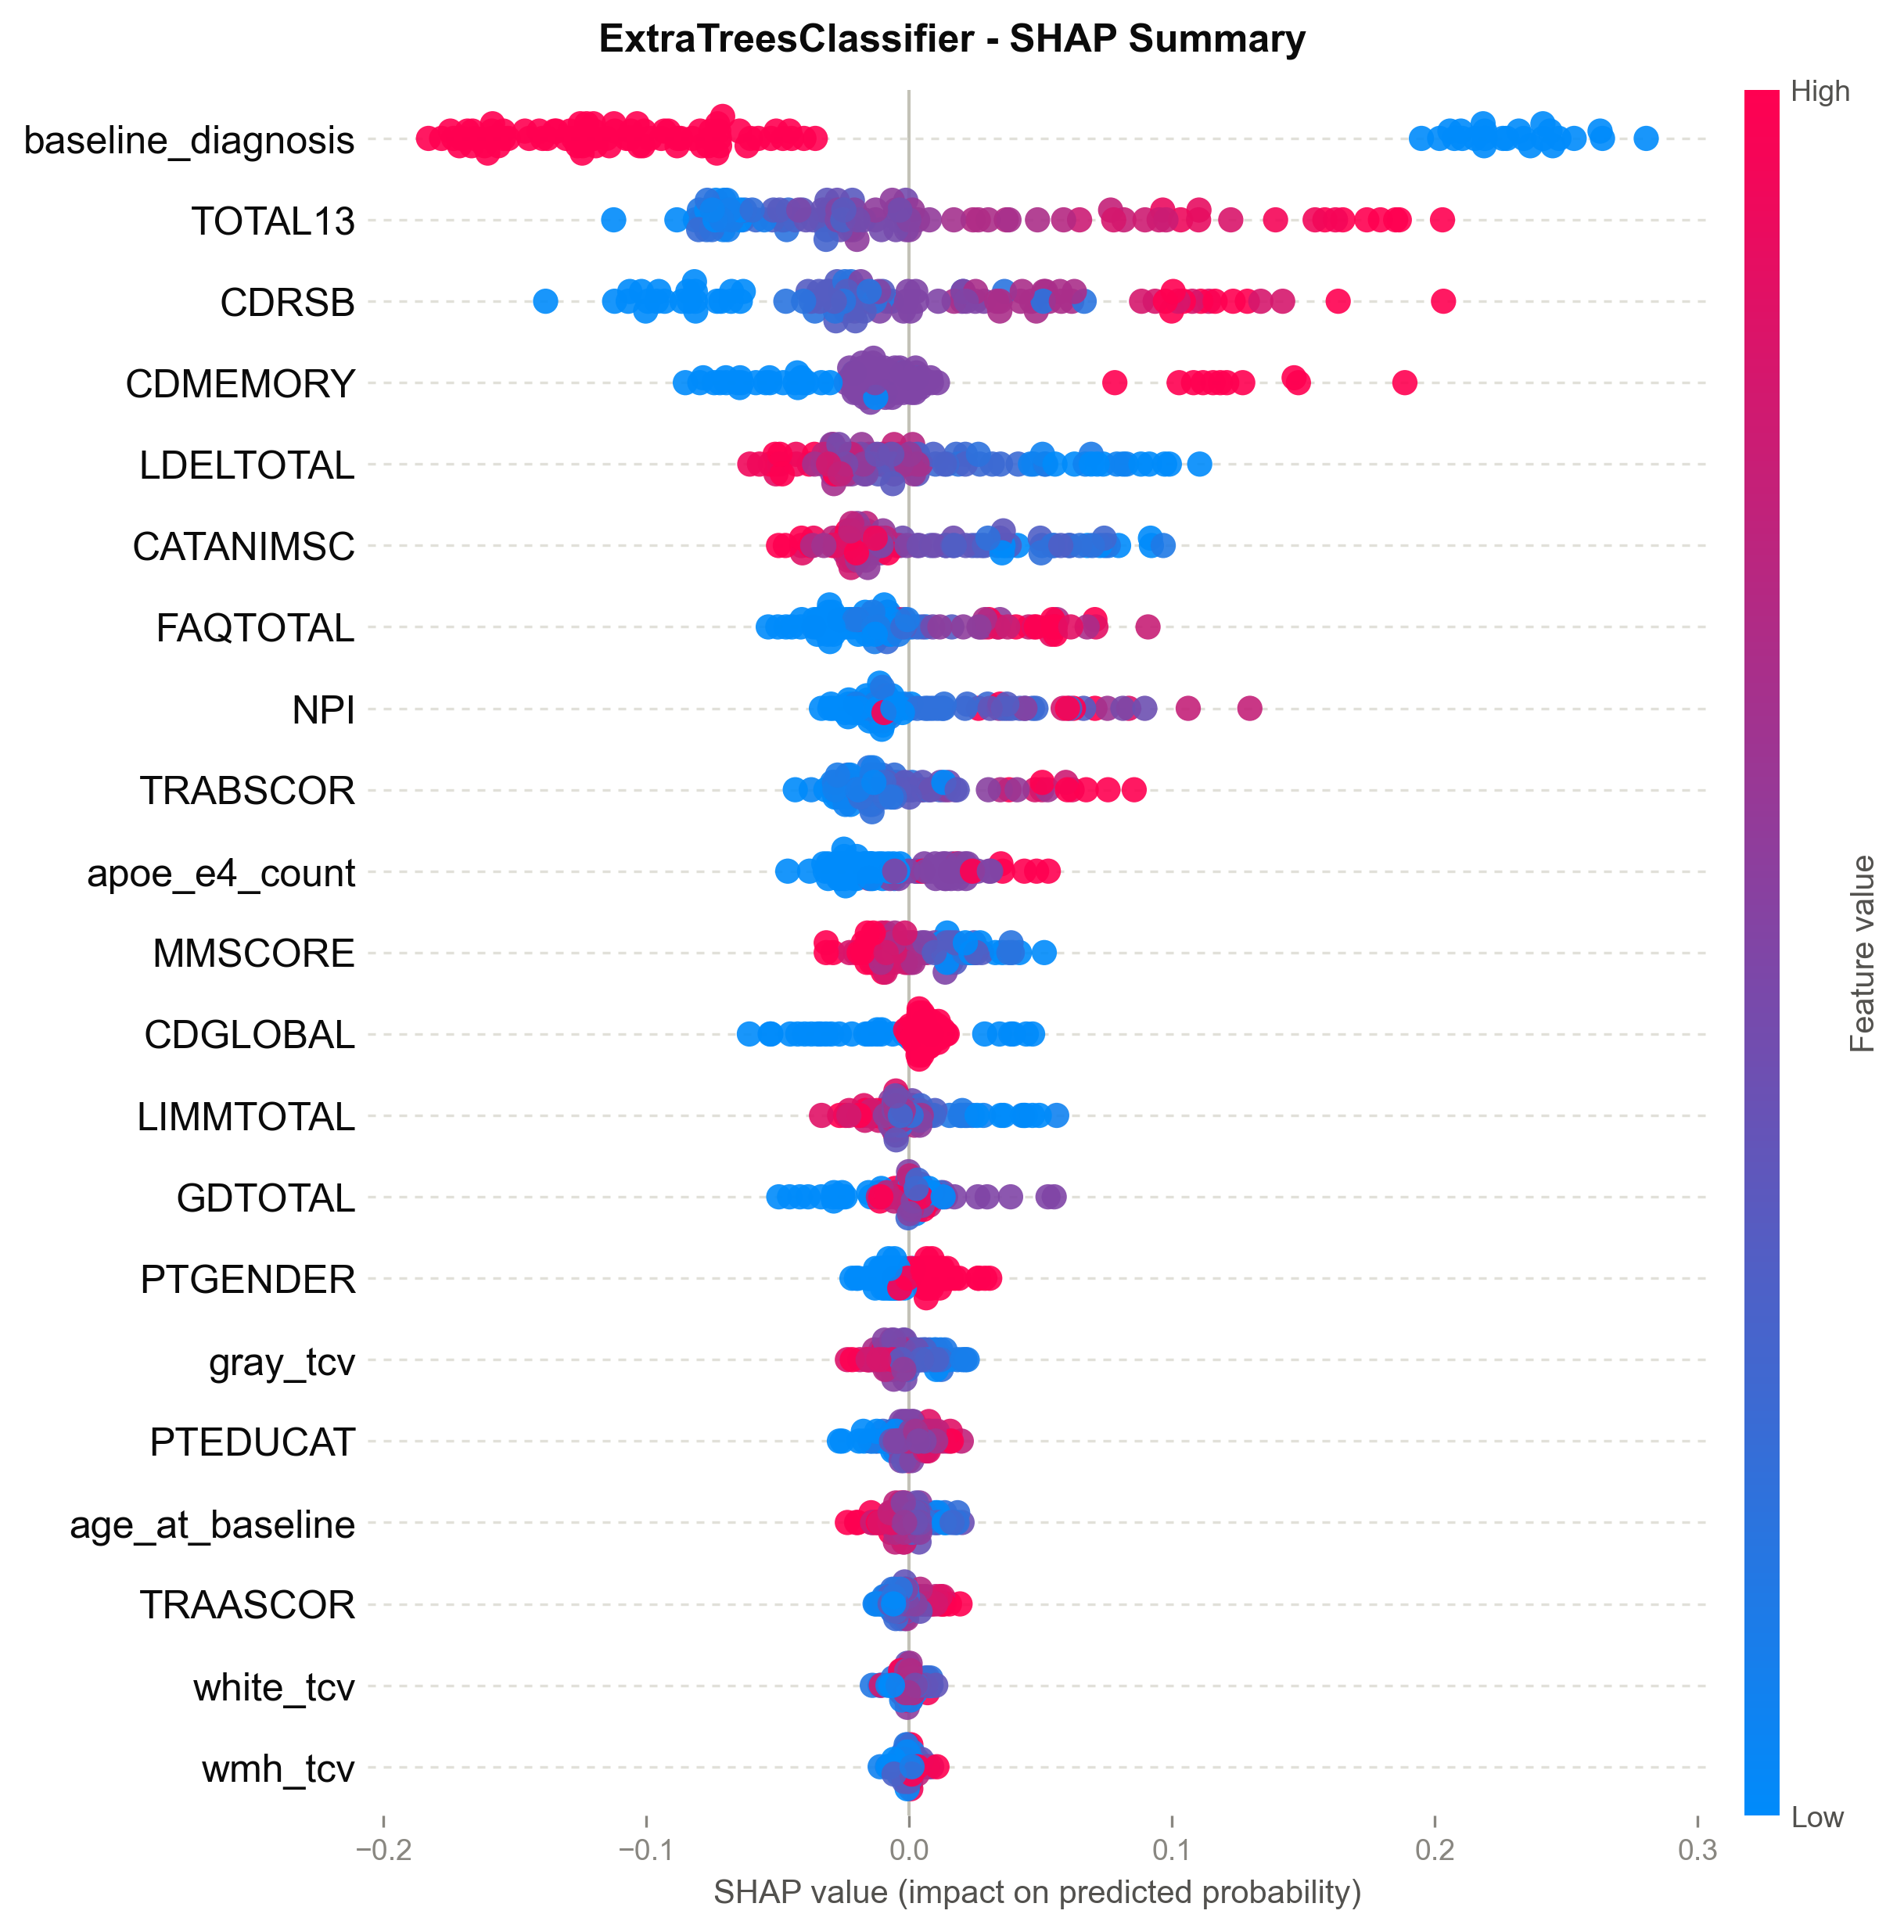
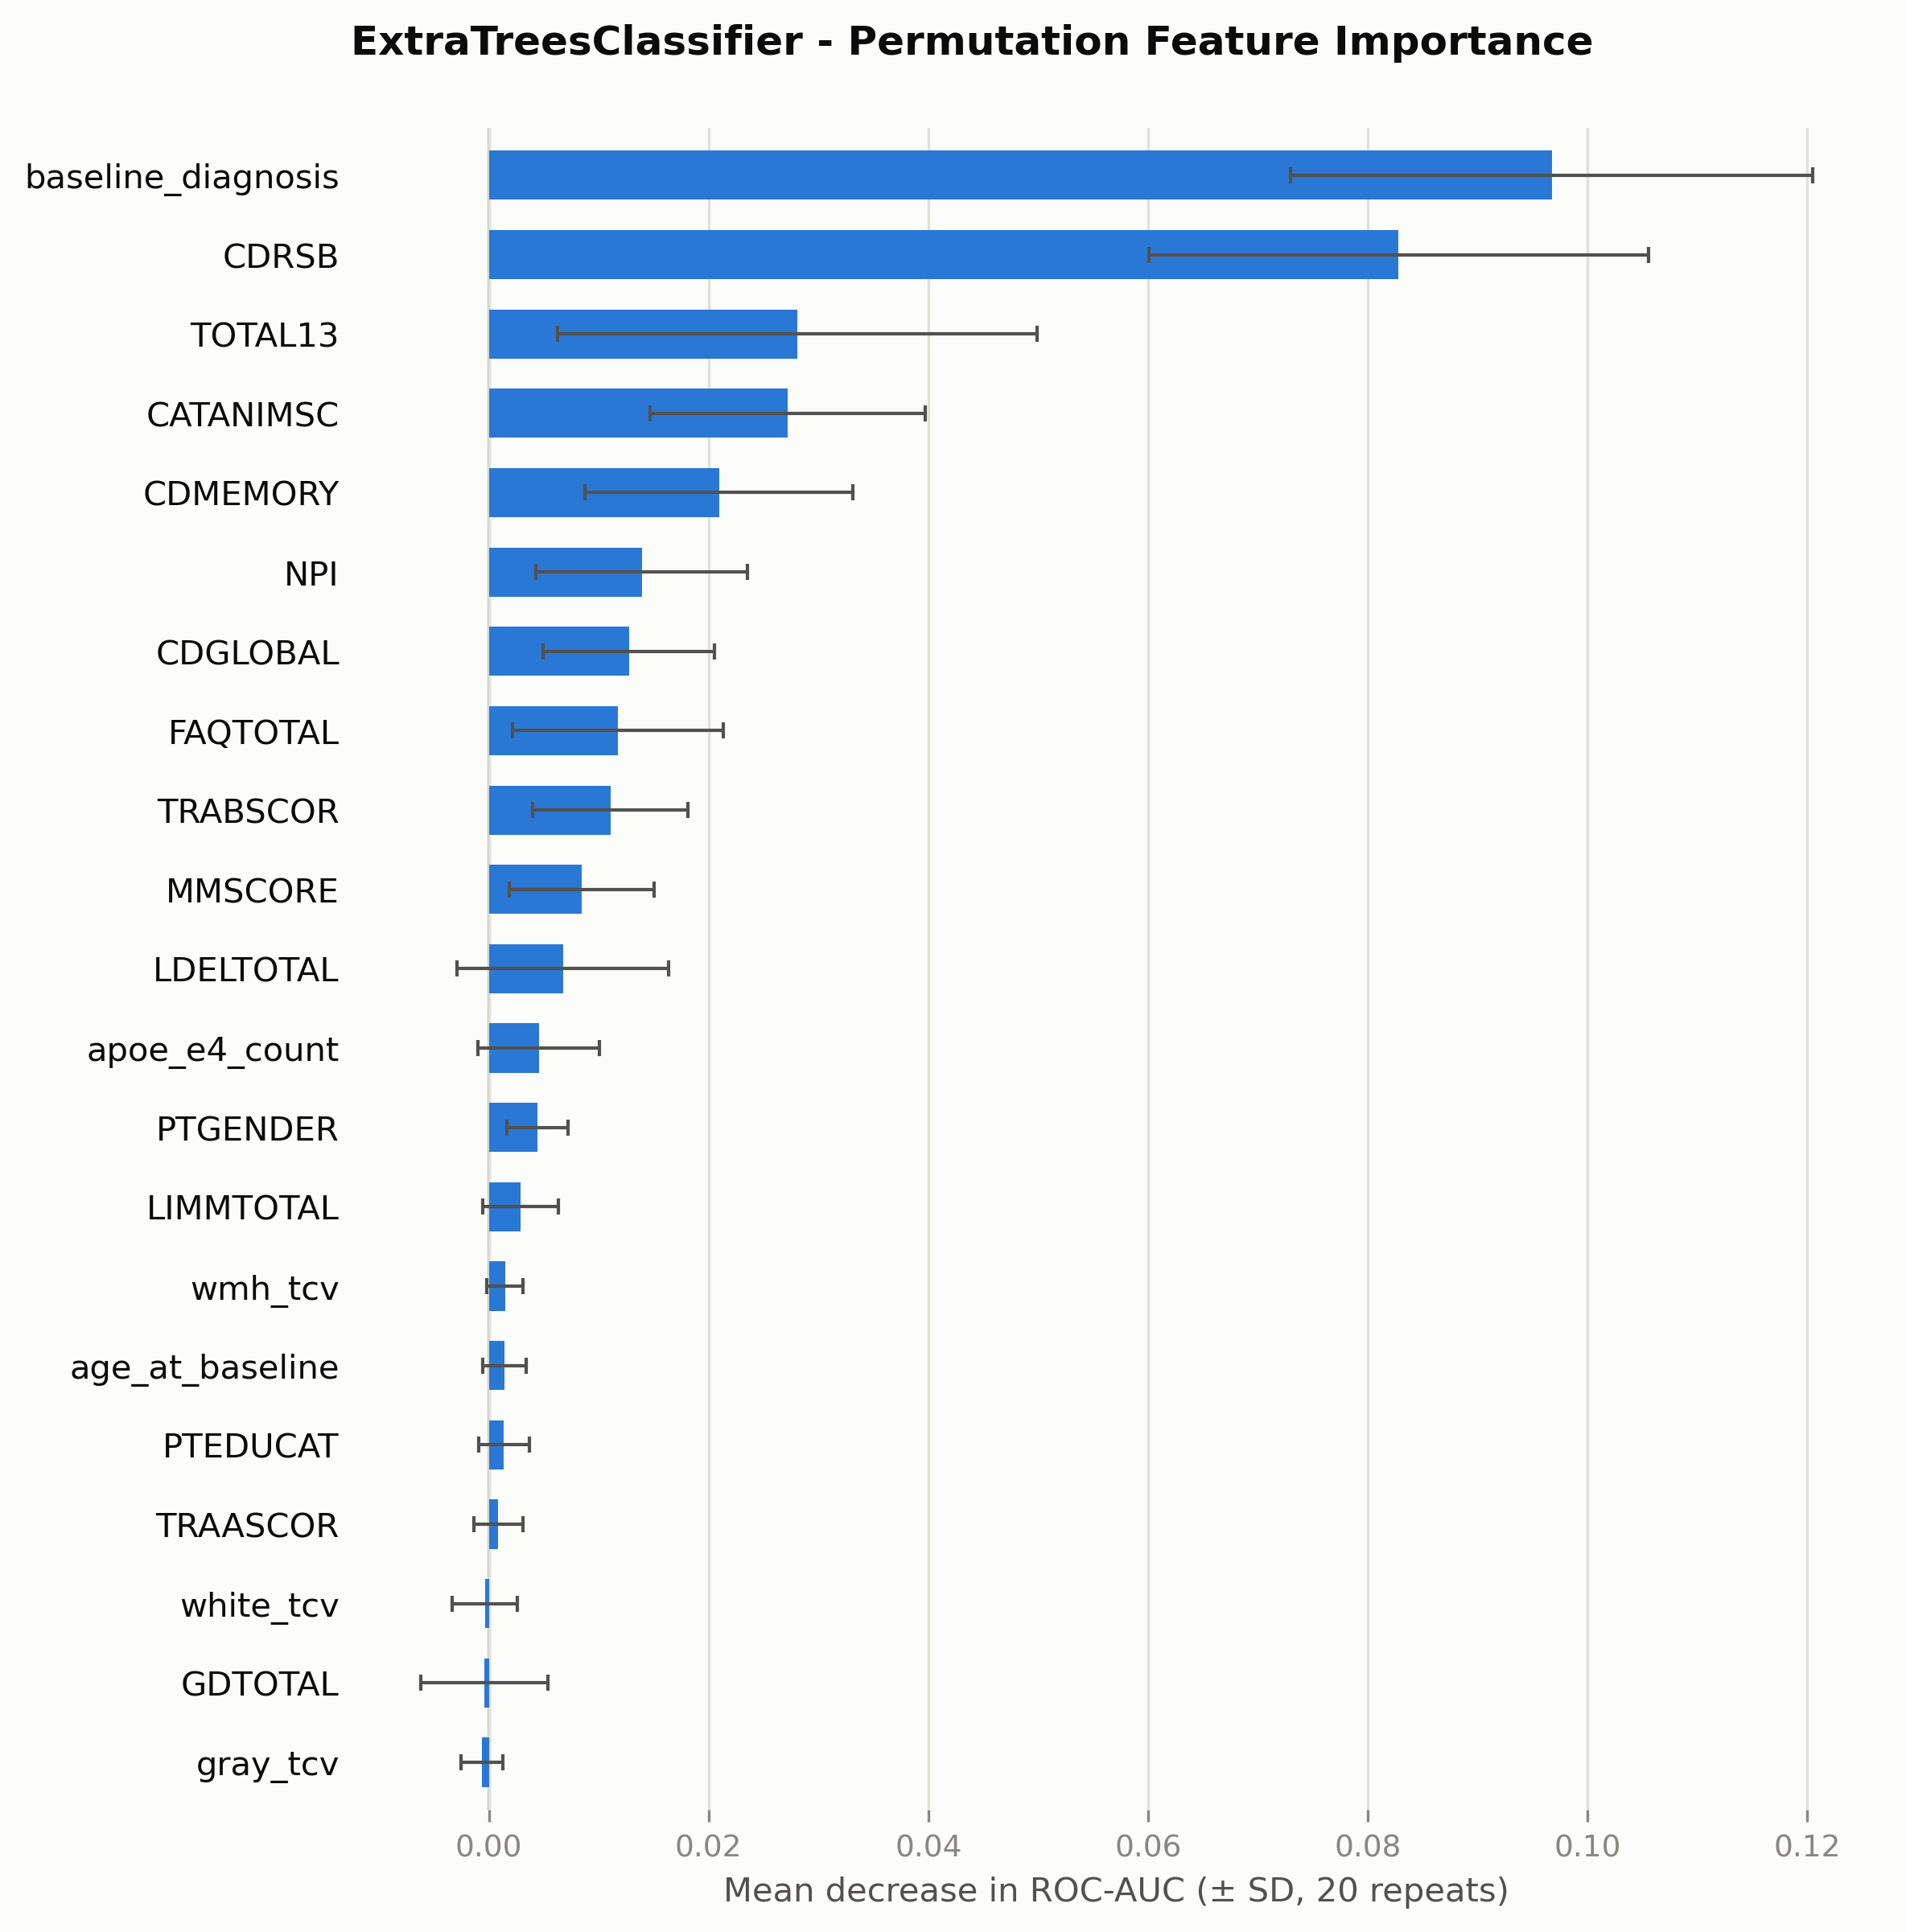
Feature Importance

Slide 5
Grading level
Score | Meaning
0 – Poor | Reasoning is incorrect, unsupported, contradictory, or misses the main point
1 – Acceptable | Reasoning is generally reasonable but incomplete, weakly supported, or contains minor issues
2 – Strong | Reasoning is correct, well-supported, complete enough, and appropriately interpreted
Rubrics
Rubric | What it grades
Evidence Grounding | Does the explanation use the actual model results?
Reasoning Correctness | Does the reasoning correctly connect the results to the conclusion?
Coverage of Important Findings | Does the explanation include the main important findings?
Explanatory Usefulness | Does the explanation clearly explain what the results mean?
Appropriate Interpretation | Does the explanation avoid unsupported or overstated claims?

Slide 6
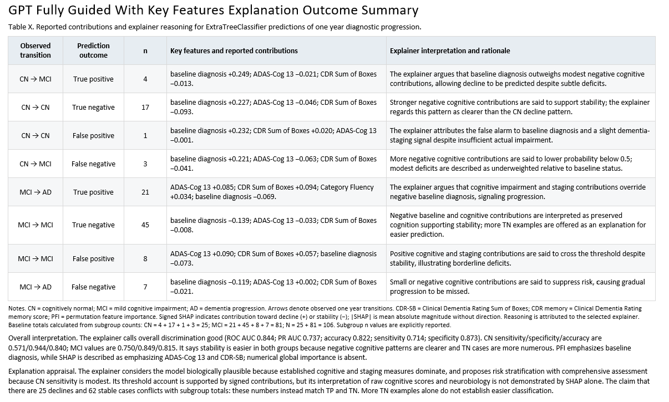

Slide 7
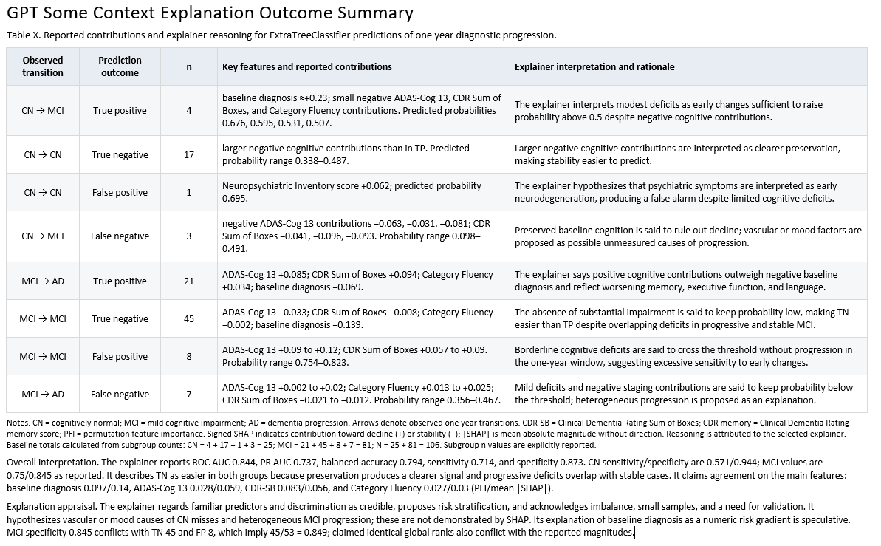

Slide 8
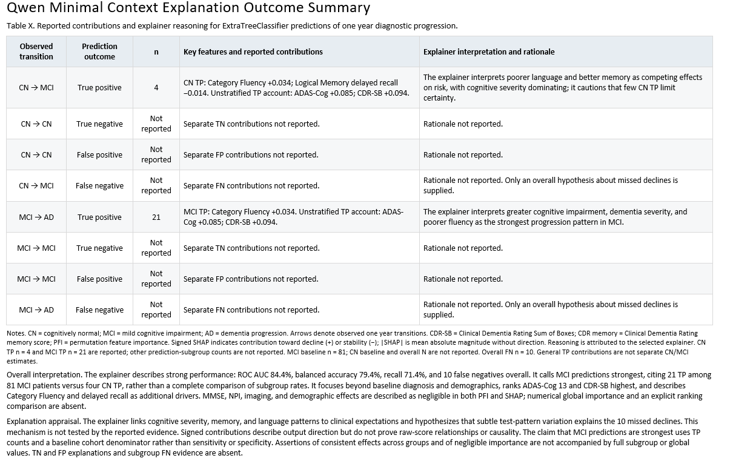
Minimal context Qwen

Slide 9
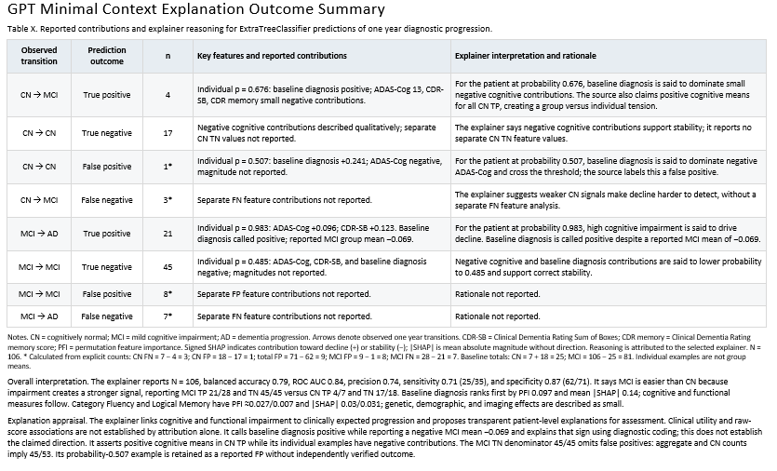
Minimal context GPT

Slide 10
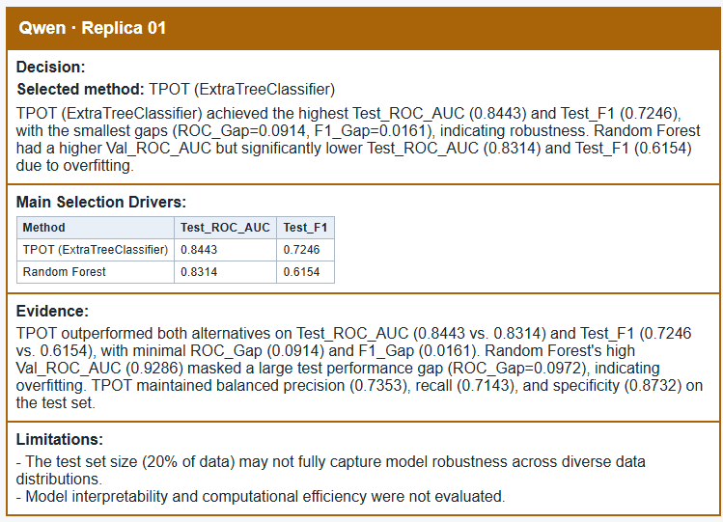
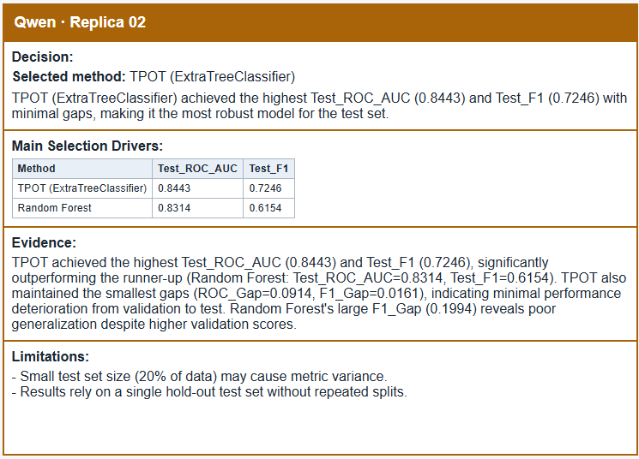
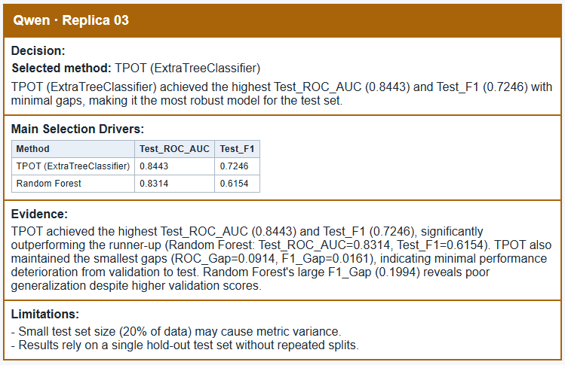
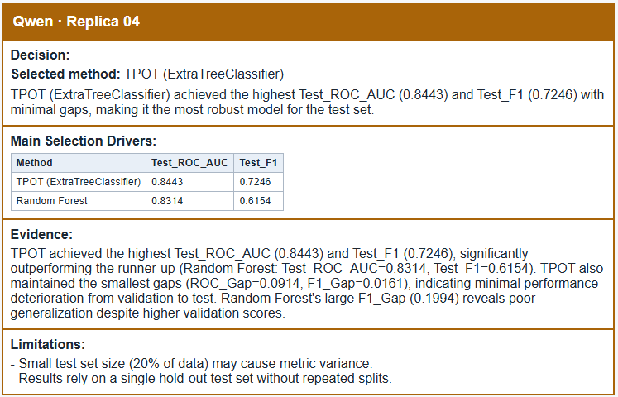
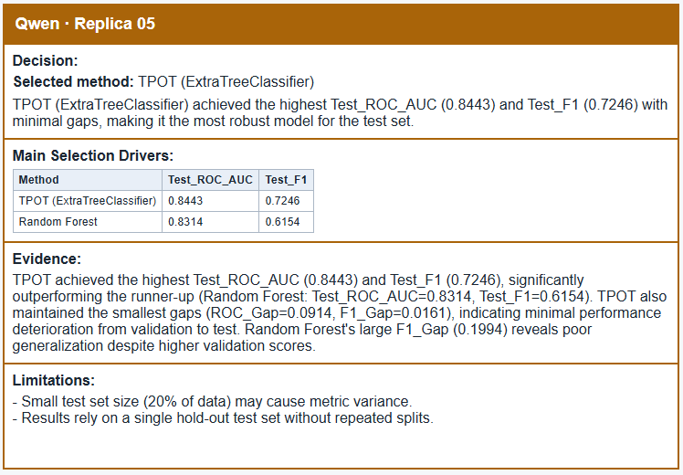
Selection Agent Replica Results
Qwen 5 Replicas, seed 42 , temp 1

Slide 11
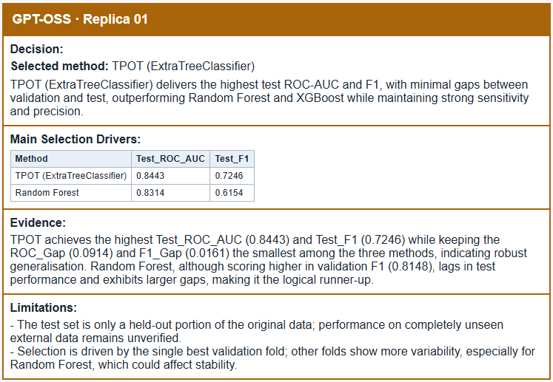
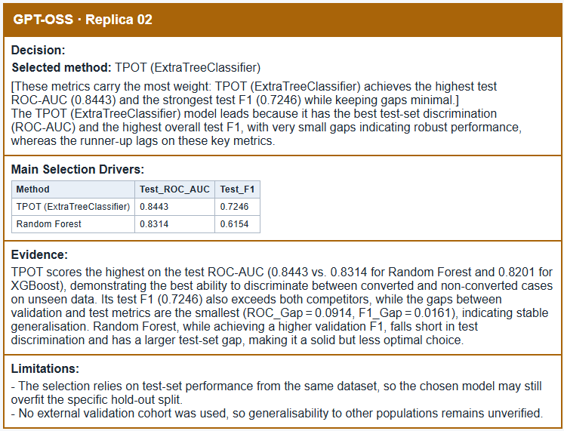
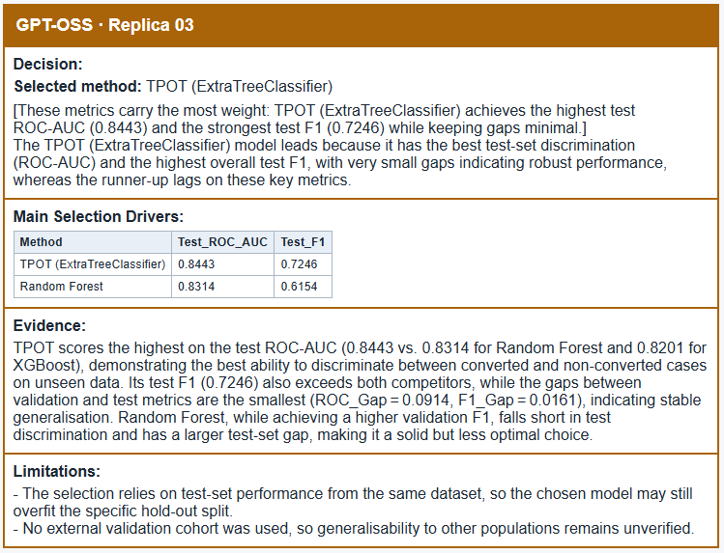

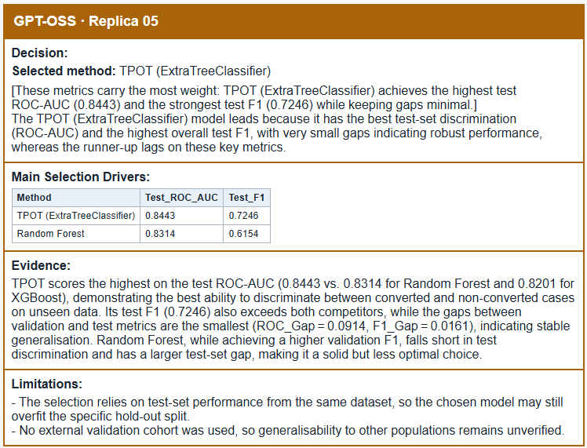
GPT-OSS 5 Replicas, seed 42 , temp 1

Slide 12
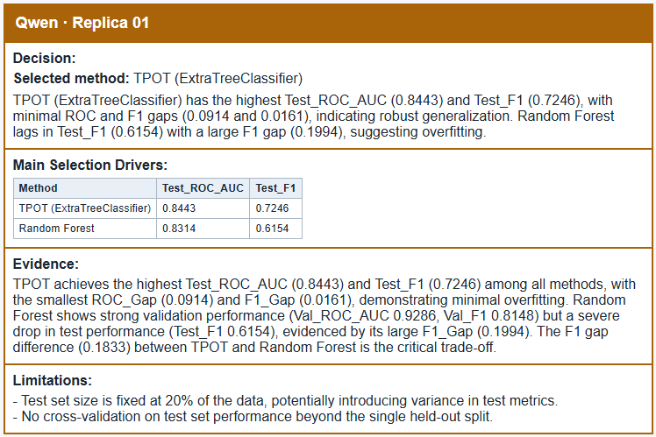
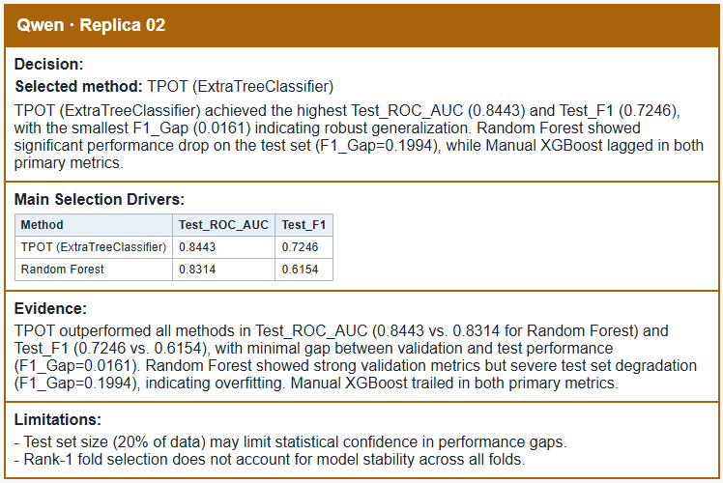


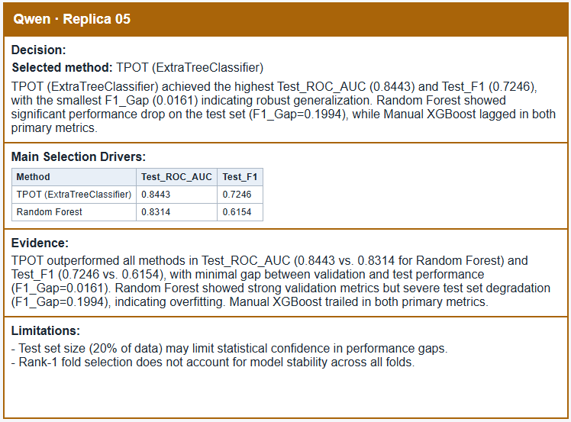
Qwen 5 Replicas, seed 42 , temp 0.7

Slide 13
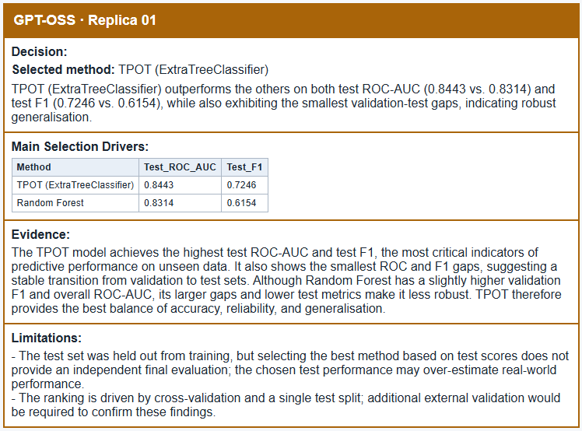
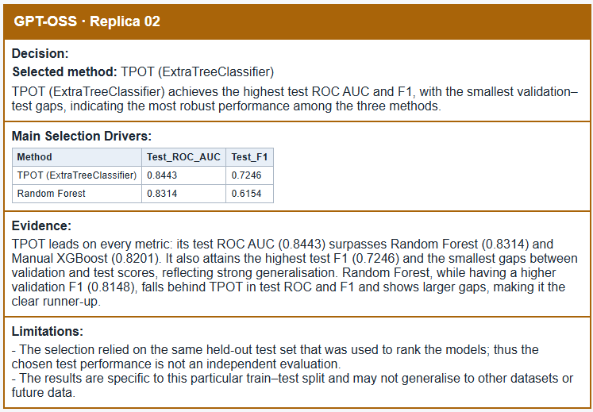
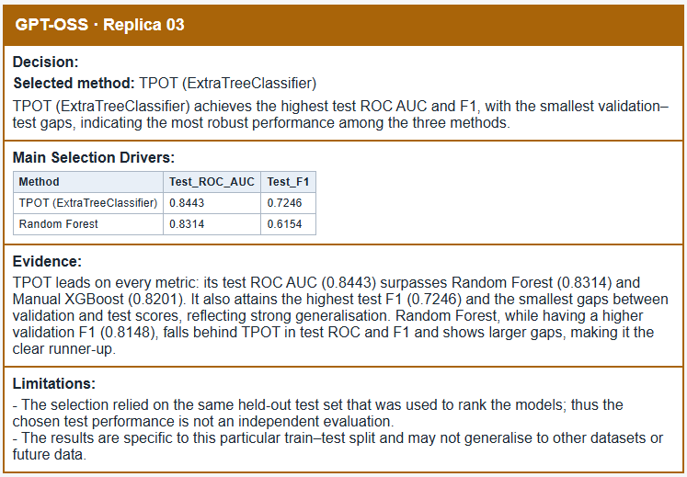

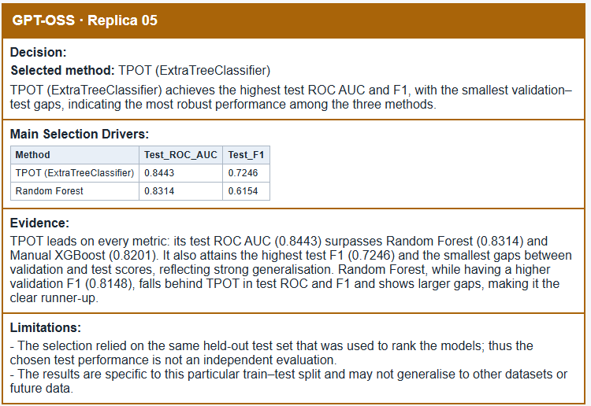
GPT-OSS 5 Replicas, seed 42 , temp 0.7

Slide 14
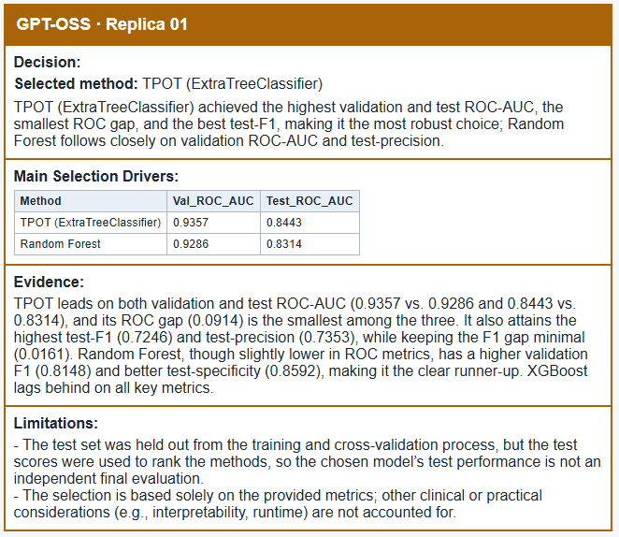
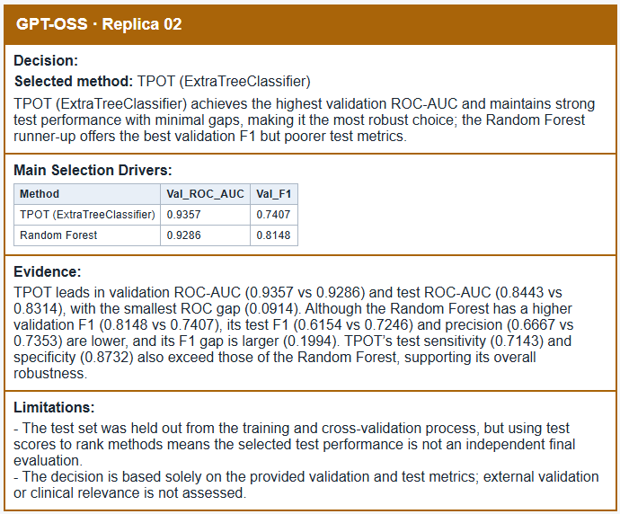
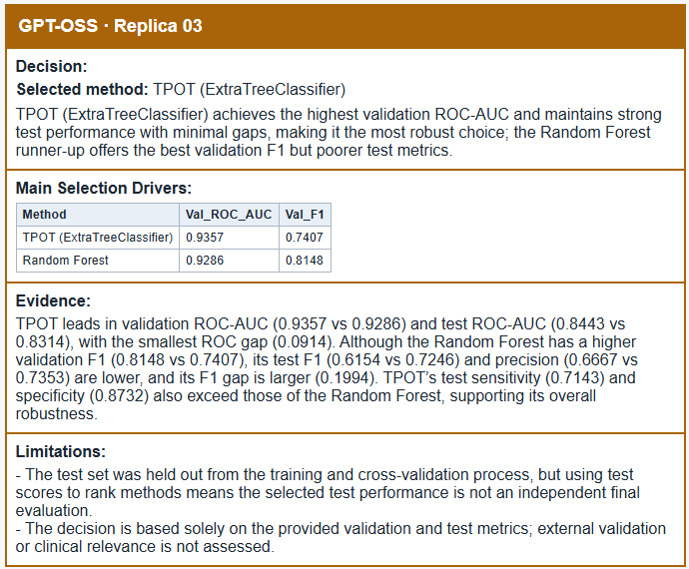

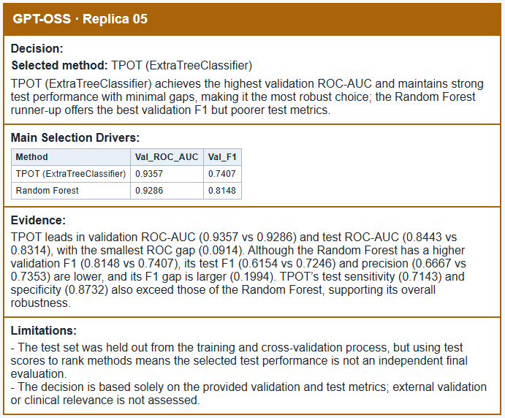
GPT-OSS 5 Replicas, seed 42 , temp 0.2

Slide 15
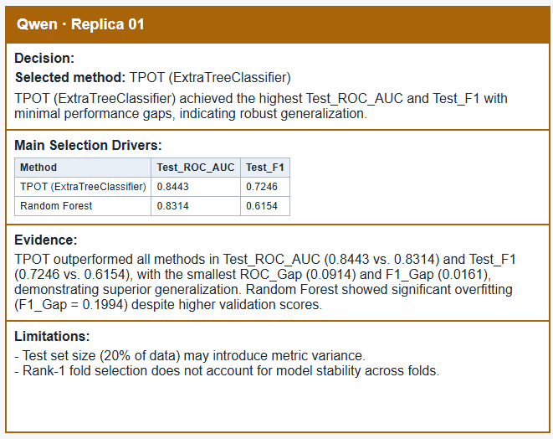
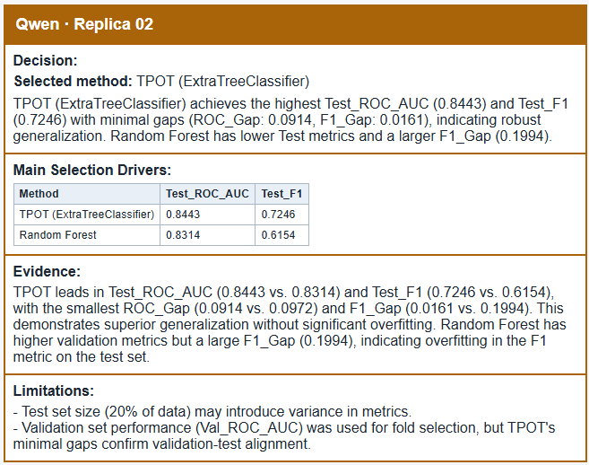
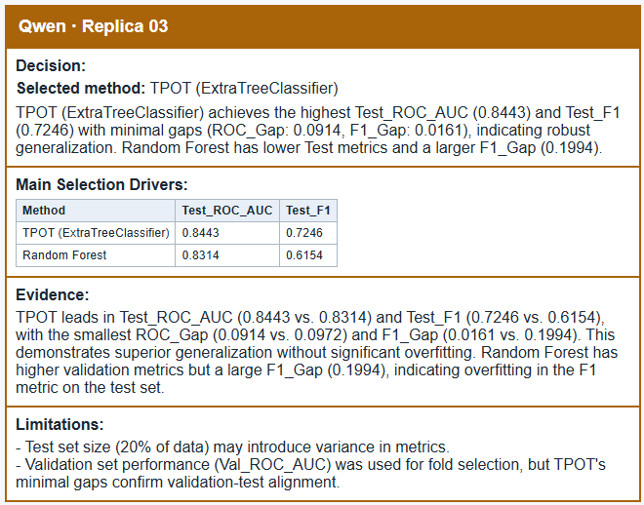
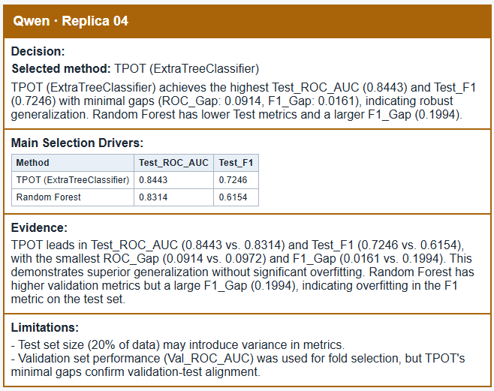
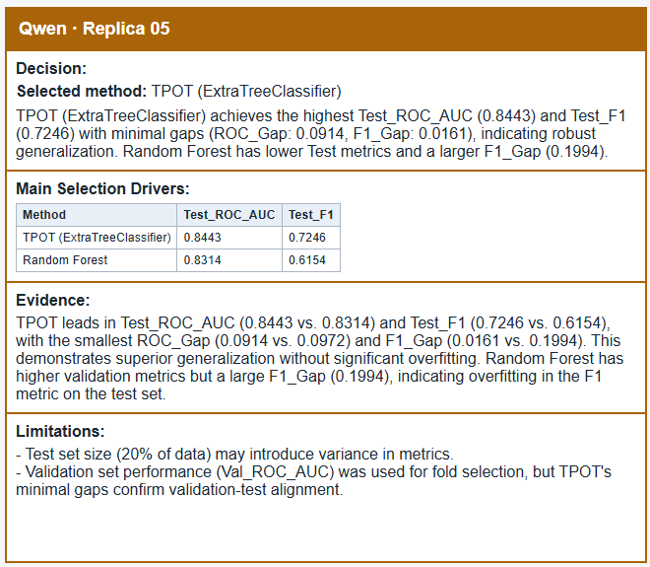
Qwen 5 Replicas, seed 42 , temp 0.2

Slide 16
GPT-OSS 5 Replicas, seed 42 , temp 0

Slide 17
Qwen 5 Replicas, seed 42 , temp 0

Slide 18
Within-agent agreement table – 3 runs per agent
Agent | Run A | Run B | Best method | Runner-up method | First metric | Second metric | Matches | Agreement (%)
GPT | run 1 | run 2 | Match | Match | Match | Match | 4 | 100.0
 | run 1 | run 3 | Match | Match | Match | Match | 4 | 100.0
 | run 2 | run 3 | Match | Match | Match | Match | 4 | 100.0
QWEN | run 1 | run 2 | Match | Match | Match | Match | 4 | 100.0
 | run 1 | run 3 | Match | Match | Match | Match | 4 | 100.0
 | run 2 | run 3 | Match | Match | Match | Match | 4 | 100.0
Between-agents agreement table – Most frequent output from the 3 runs per agent
Field | GPT | Qwen | Agreement
Best method | TPOT | TPOT | Match
Runner-up method | Manual Random Forest | Manual Random Forest | Match
First metric | Test_ROC_AUC | Test_ROC_AUC | Match
Second metric | Test_F1 | Test_F1 | Match

Slide 19
Within-agent agreement table – 5 replica runs per agent
Agent | Temperature | Best method | Runner-up method | First metric | Second metric | Agreement (%)
GPT | 0 | Match | Match | Match | Match | 100.0
 | 0.7 | Match | Match | Match | Match | 100.0
 | 1 | Match | Match | Match | Match | 100.0
QWEN | 0 | Match | Match | Match | Match | 100.0
 | 0.7 | Match | Match | Match | Match | 100.0
 | 1 | Match | Match | Match | Match | 100.0
Agent | Temp 1 | Temp 2 | Temp 3 | Best method | Runner-up method | First metric | Second metric | Agreement (%)
GPT | 0 | 0.7 | 1 | Match | Match | Match | Match | 100.0
QWEN | 0 | 0.7 | 1 | Match | Match | Match | Match | 100.0
Between-agents agreement table – Most frequent output from the 5 replicas per agent
Field | GPT | Qwen | Agreement
Best method | TPOT | TPOT | Match
Runner-up method | Manual Random Forest | Manual Random Forest | Match
First metric | Test_ROC_AUC | Test_ROC_AUC | Match
Second metric | Test_F1 | Test_F1 | Match

Slide 20

Cohen’s Kappa limitation for our use case
What it calculates: Agreement between two raters or agents, after accounting for agreement expected by chance.
How it works: Compares their actual agreement with the agreement expected from how often each agent uses each answer.
Our results: Both agents give the same answer across all three runs for each of the four fields.
Why it is undefined: Actual and expected agreement are both 100%, making the kappa formula divide zero by zero.
What that means: The agents agree perfectly on these outputs, but there is no variation for kappa to assess beyond expected agreement. We also can not use it to compare between agents as there will only be one pair of answer per field which is still insufficient for variation.

Slide 21
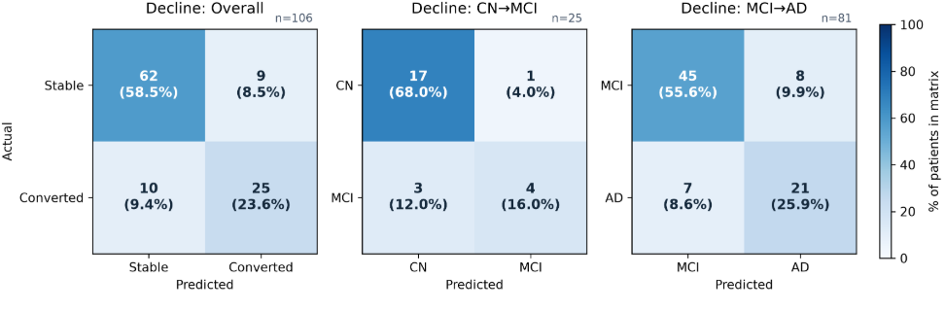
Agent Results

Slide 22
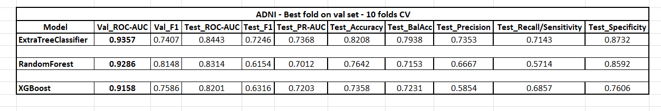
Performance – Overall Group (N = 106)
CN Baseline Group (N = 25) (CN-CN & CN-MCI)
Model | TN | FP | FN | TP | Accuracy | Precision | Recall | F1
Random Forest | 17 | 1 | 6 | 1 | 0.720 | 0.500 | 0.143 | 0.222
TPOT (Extra Trees) | 17 | 1 | 3 | 4 | 0.840 | 0.800 | 0.571 | 0.667
XGBoost | 14 | 4 | 3 | 4 | 0.720 | 0.500 | 0.571 | 0.533
MCI Baseline Group (N = 81) (MCI-MCI & MCI-AD)
Model | TN | FP | FN | TP | Accuracy | Precision | Recall | F1
Random Forest | 44 | 9 | 9 | 19 | 0.778 | 0.679 | 0.679 | 0.679
TPOT (Extra Trees) | 45 | 8 | 7 | 21 | 0.815 | 0.724 | 0.750 | 0.737
XGBoost | 40 | 13 | 8 | 20 | 0.741 | 0.606 | 0.714 | 0.656

Slide 23
Confusion Matrix – Overall Group (N = 106)
Model | TN | FP | FN | TP | Accuracy | Precision | Recall | F1
Random Forest | 61 | 10 | 15 | 20 | 0.764 | 0.667 | 0.571 | 0.615
TPOT (Extra Trees) | 62 | 9 | 10 | 25 | 0.821 | 0.735 | 0.714 | 0.725
XGBoost | 54 | 17 | 11 | 24 | 0.736 | 0.585 | 0.686 | 0.632
CN Baseline Group (N = 25) (CN-CN & CN-MCI)
Model | TN | FP | FN | TP | Accuracy | Precision | Recall | F1
Random Forest | 17 | 1 | 6 | 1 | 0.720 | 0.500 | 0.143 | 0.222
TPOT (Extra Trees) | 17 | 1 | 3 | 4 | 0.840 | 0.800 | 0.571 | 0.667
XGBoost | 14 | 4 | 3 | 4 | 0.720 | 0.500 | 0.571 | 0.533
MCI Baseline Group (N = 81) (MCI-MCI & MCI-AD)
Model | TN | FP | FN | TP | Accuracy | Precision | Recall | F1
Random Forest | 44 | 9 | 9 | 19 | 0.778 | 0.679 | 0.679 | 0.679
TPOT (Extra Trees) | 45 | 8 | 7 | 21 | 0.815 | 0.724 | 0.750 | 0.737
XGBoost | 40 | 13 | 8 | 20 | 0.741 | 0.606 | 0.714 | 0.656

Slide 24
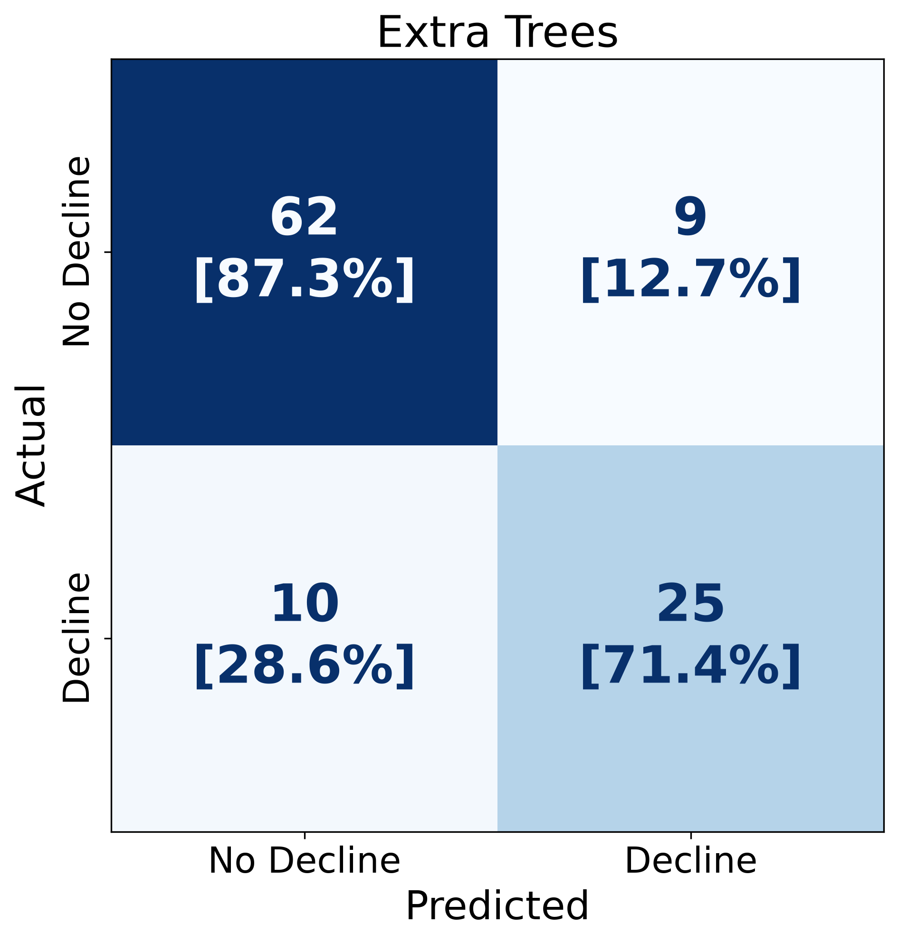
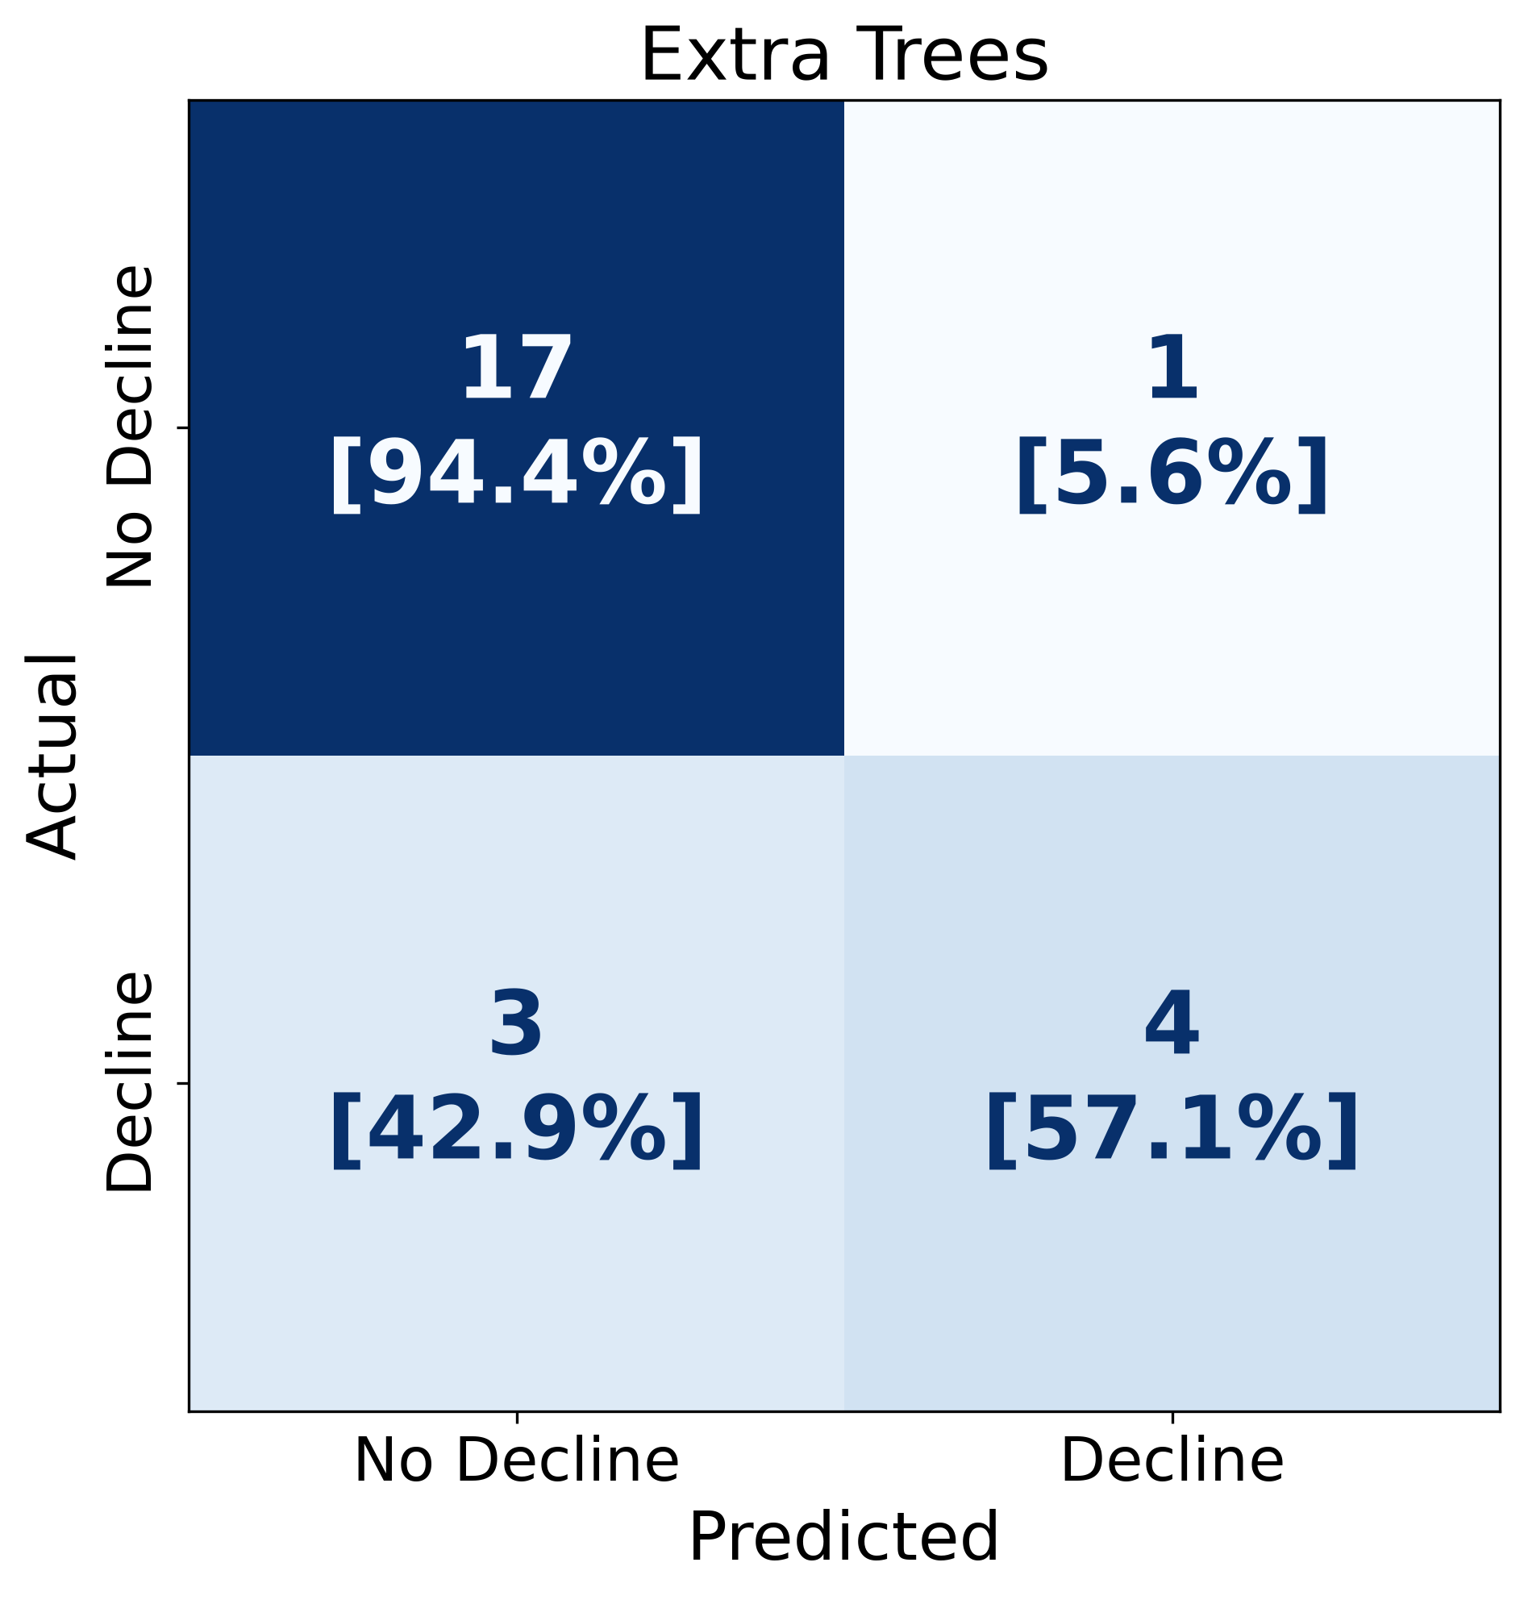
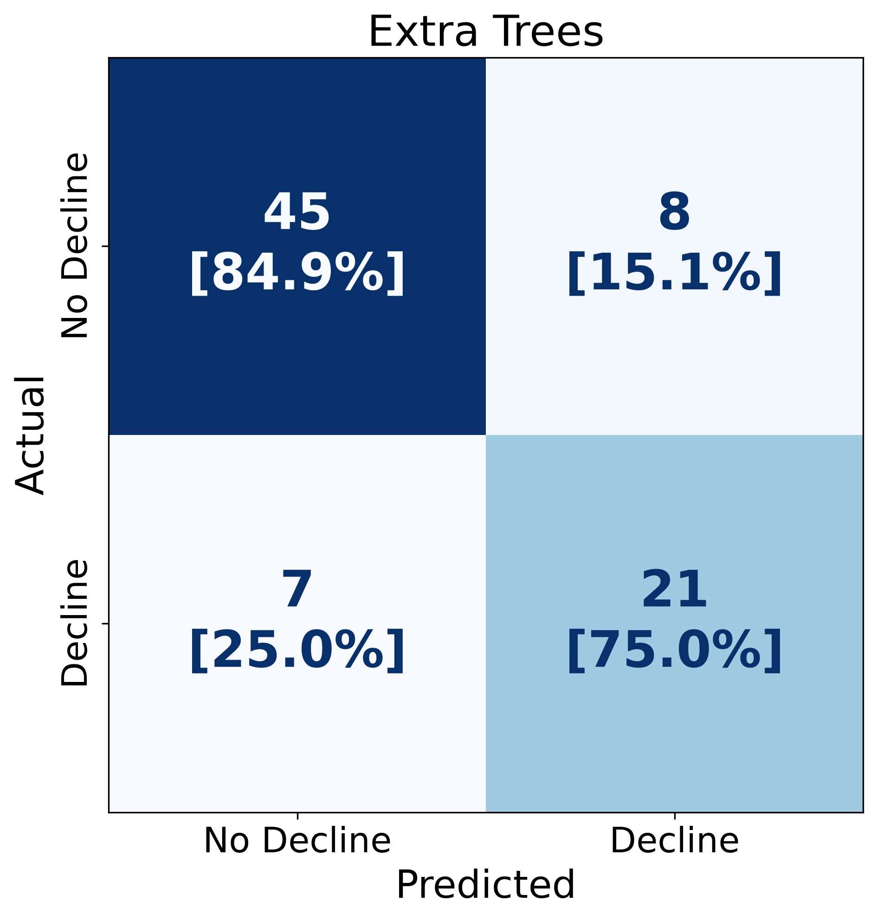
Extra Trees Confusion Matrices by Baseline Group
Overall Group (N=106)
Best model is TPOT(Extra Trees) in the middle
MCI Baseline Group (N=81)
CN Baseline Group (N=25)

Slide 25
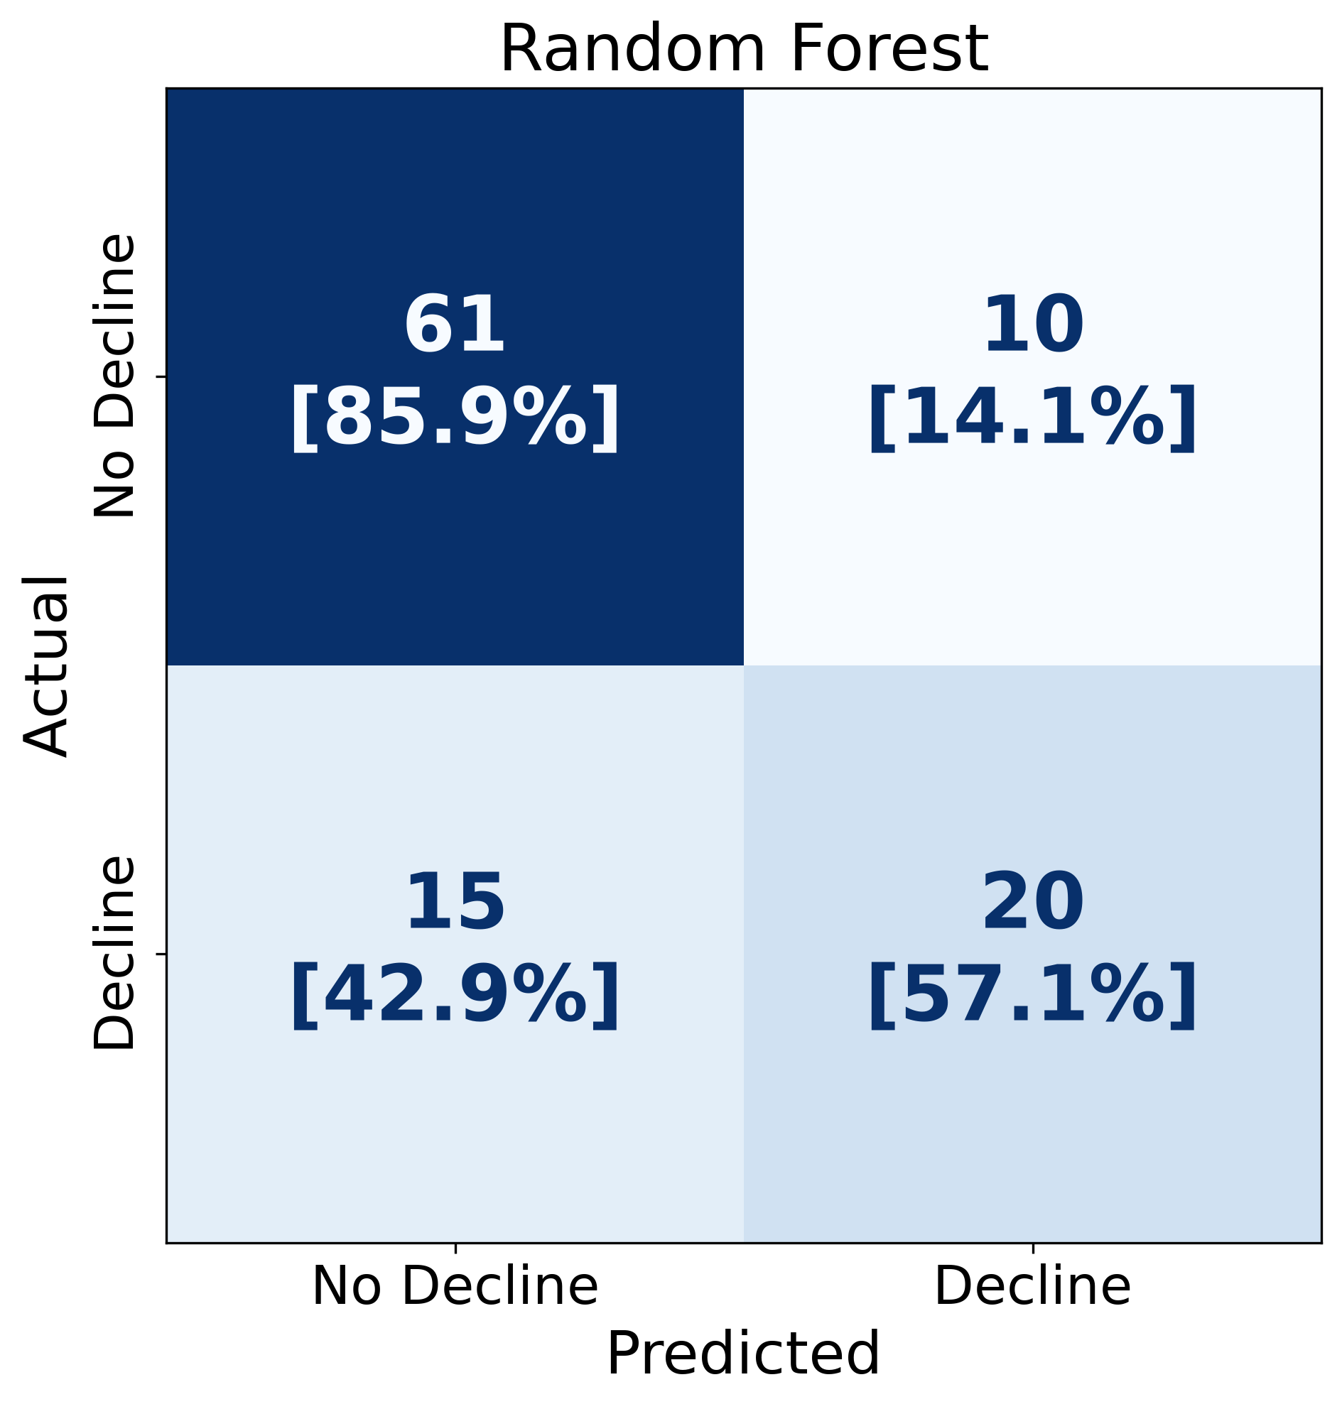
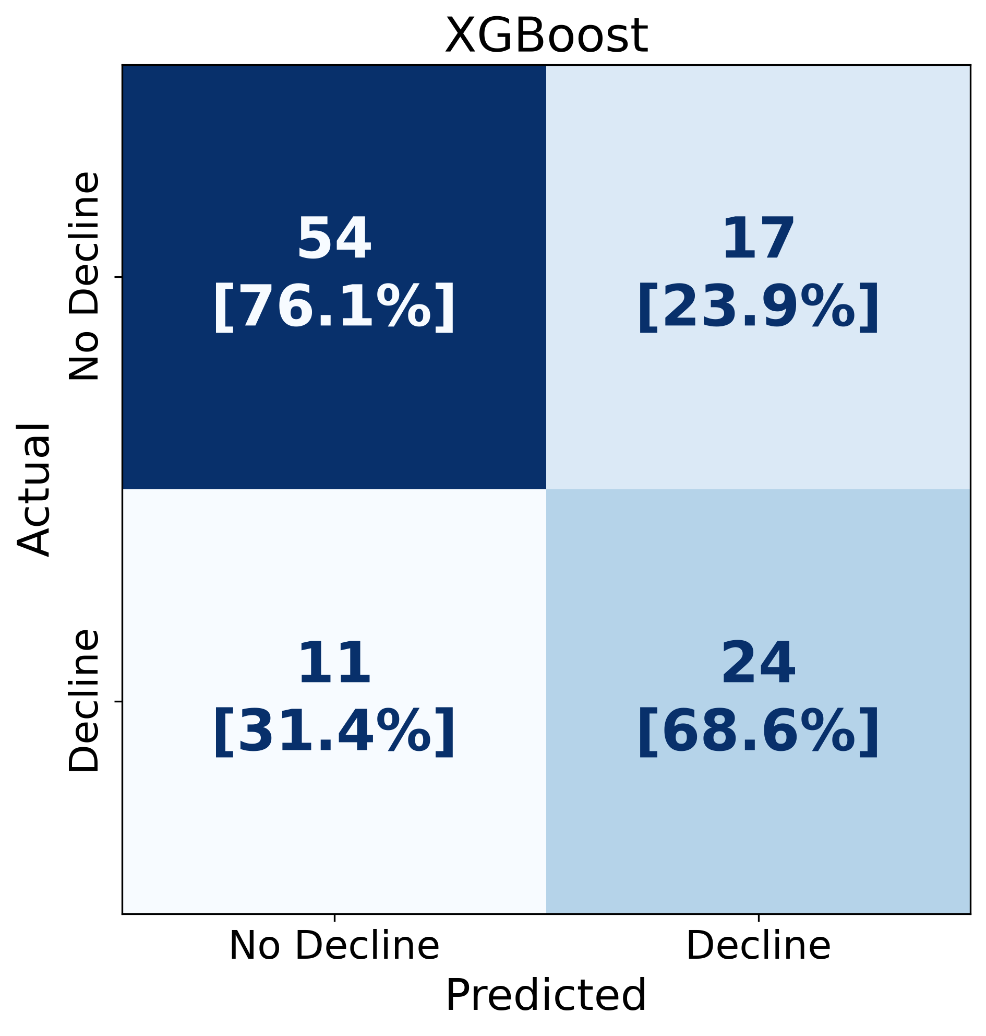
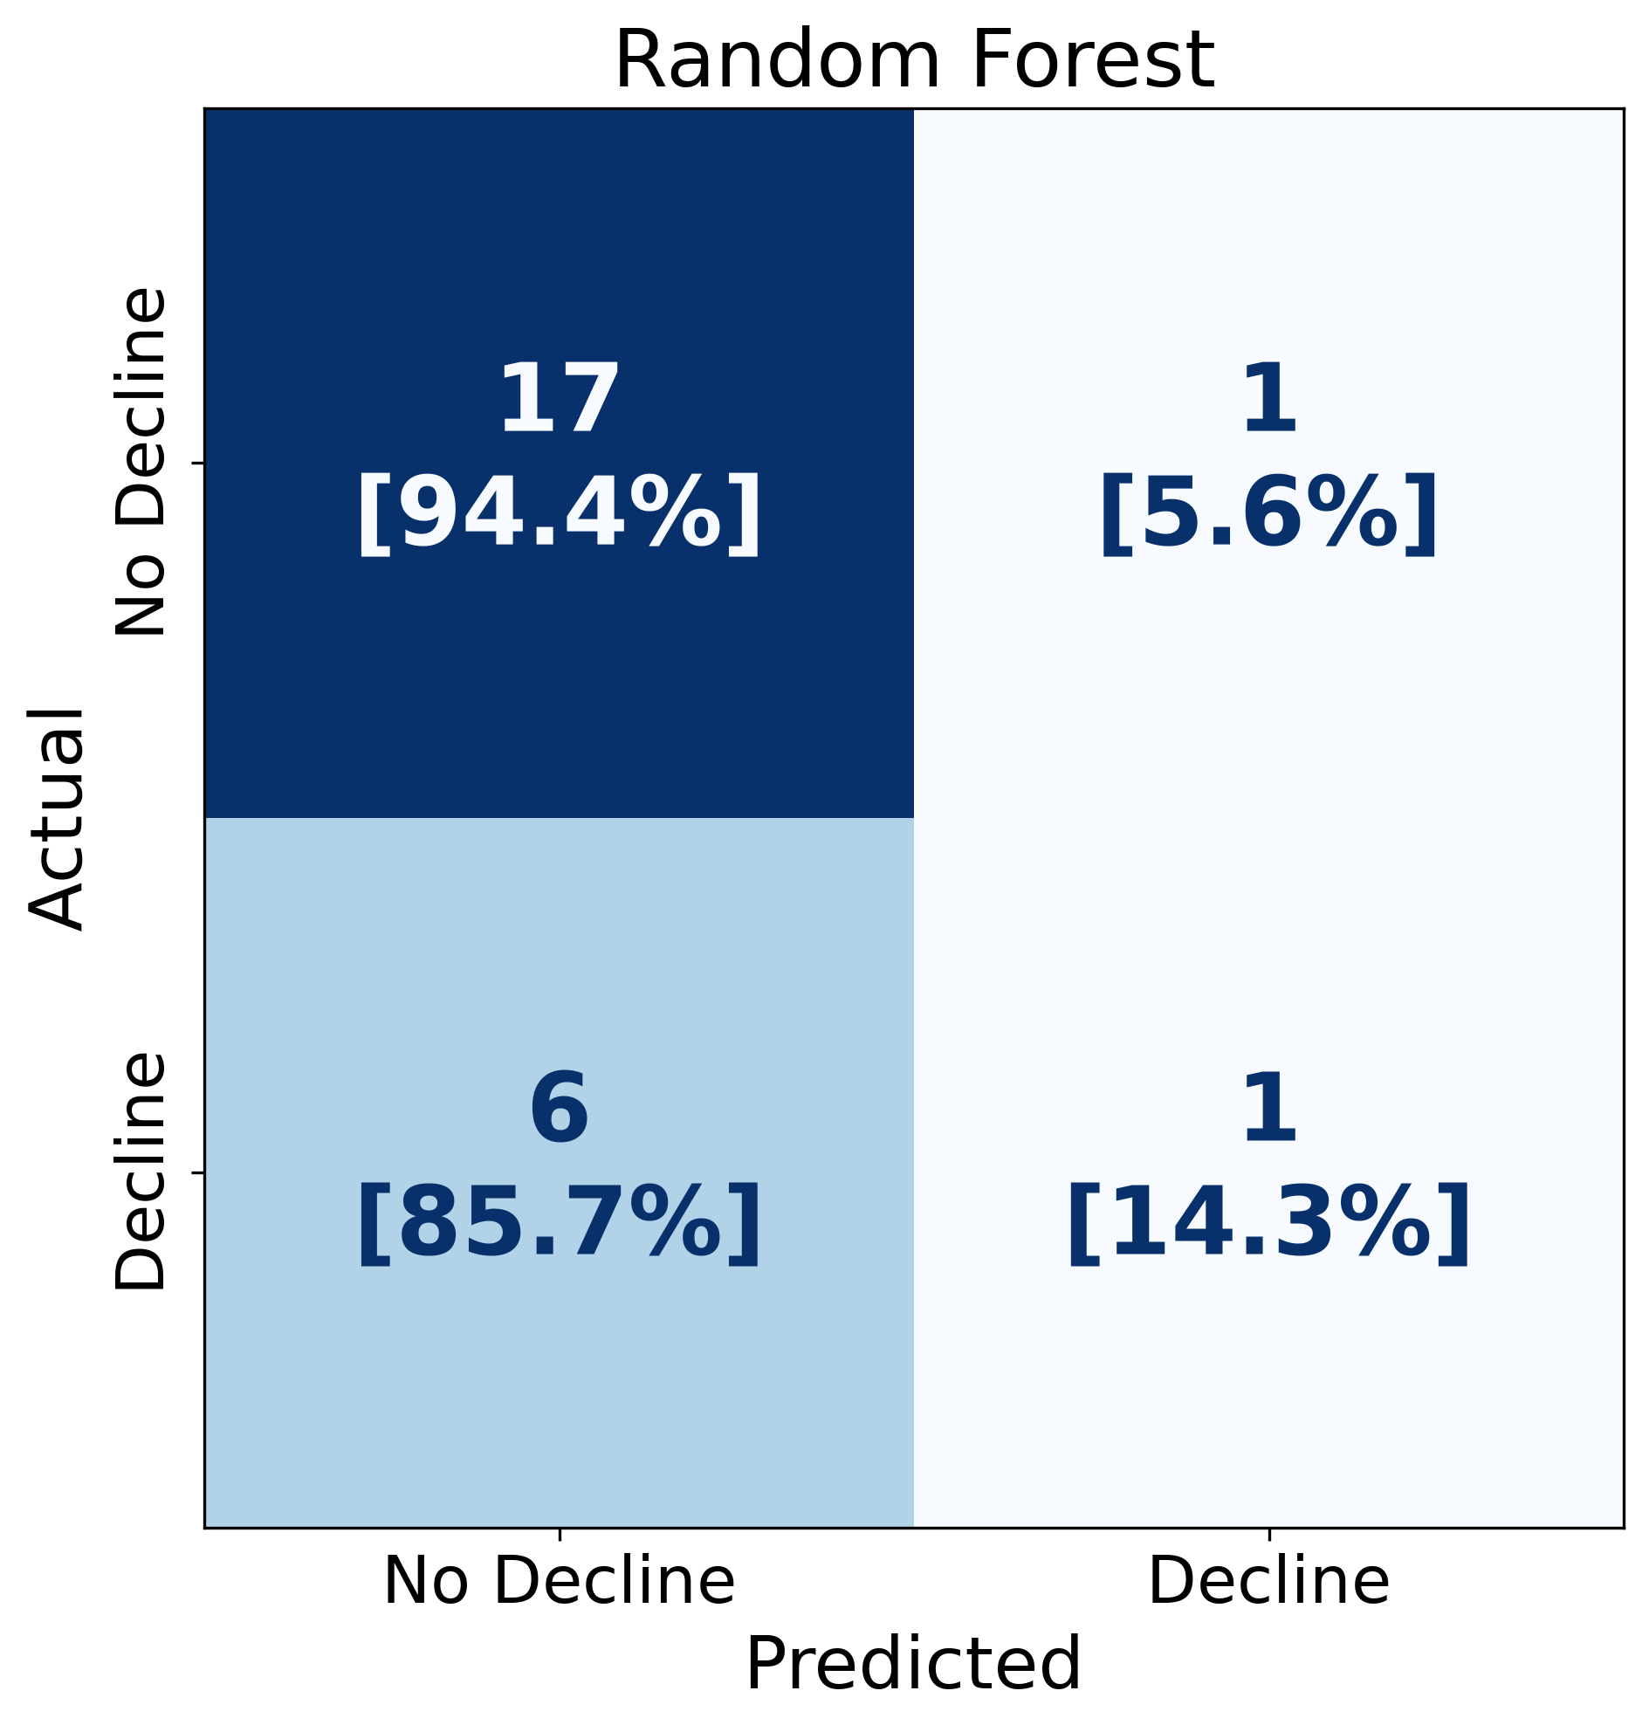
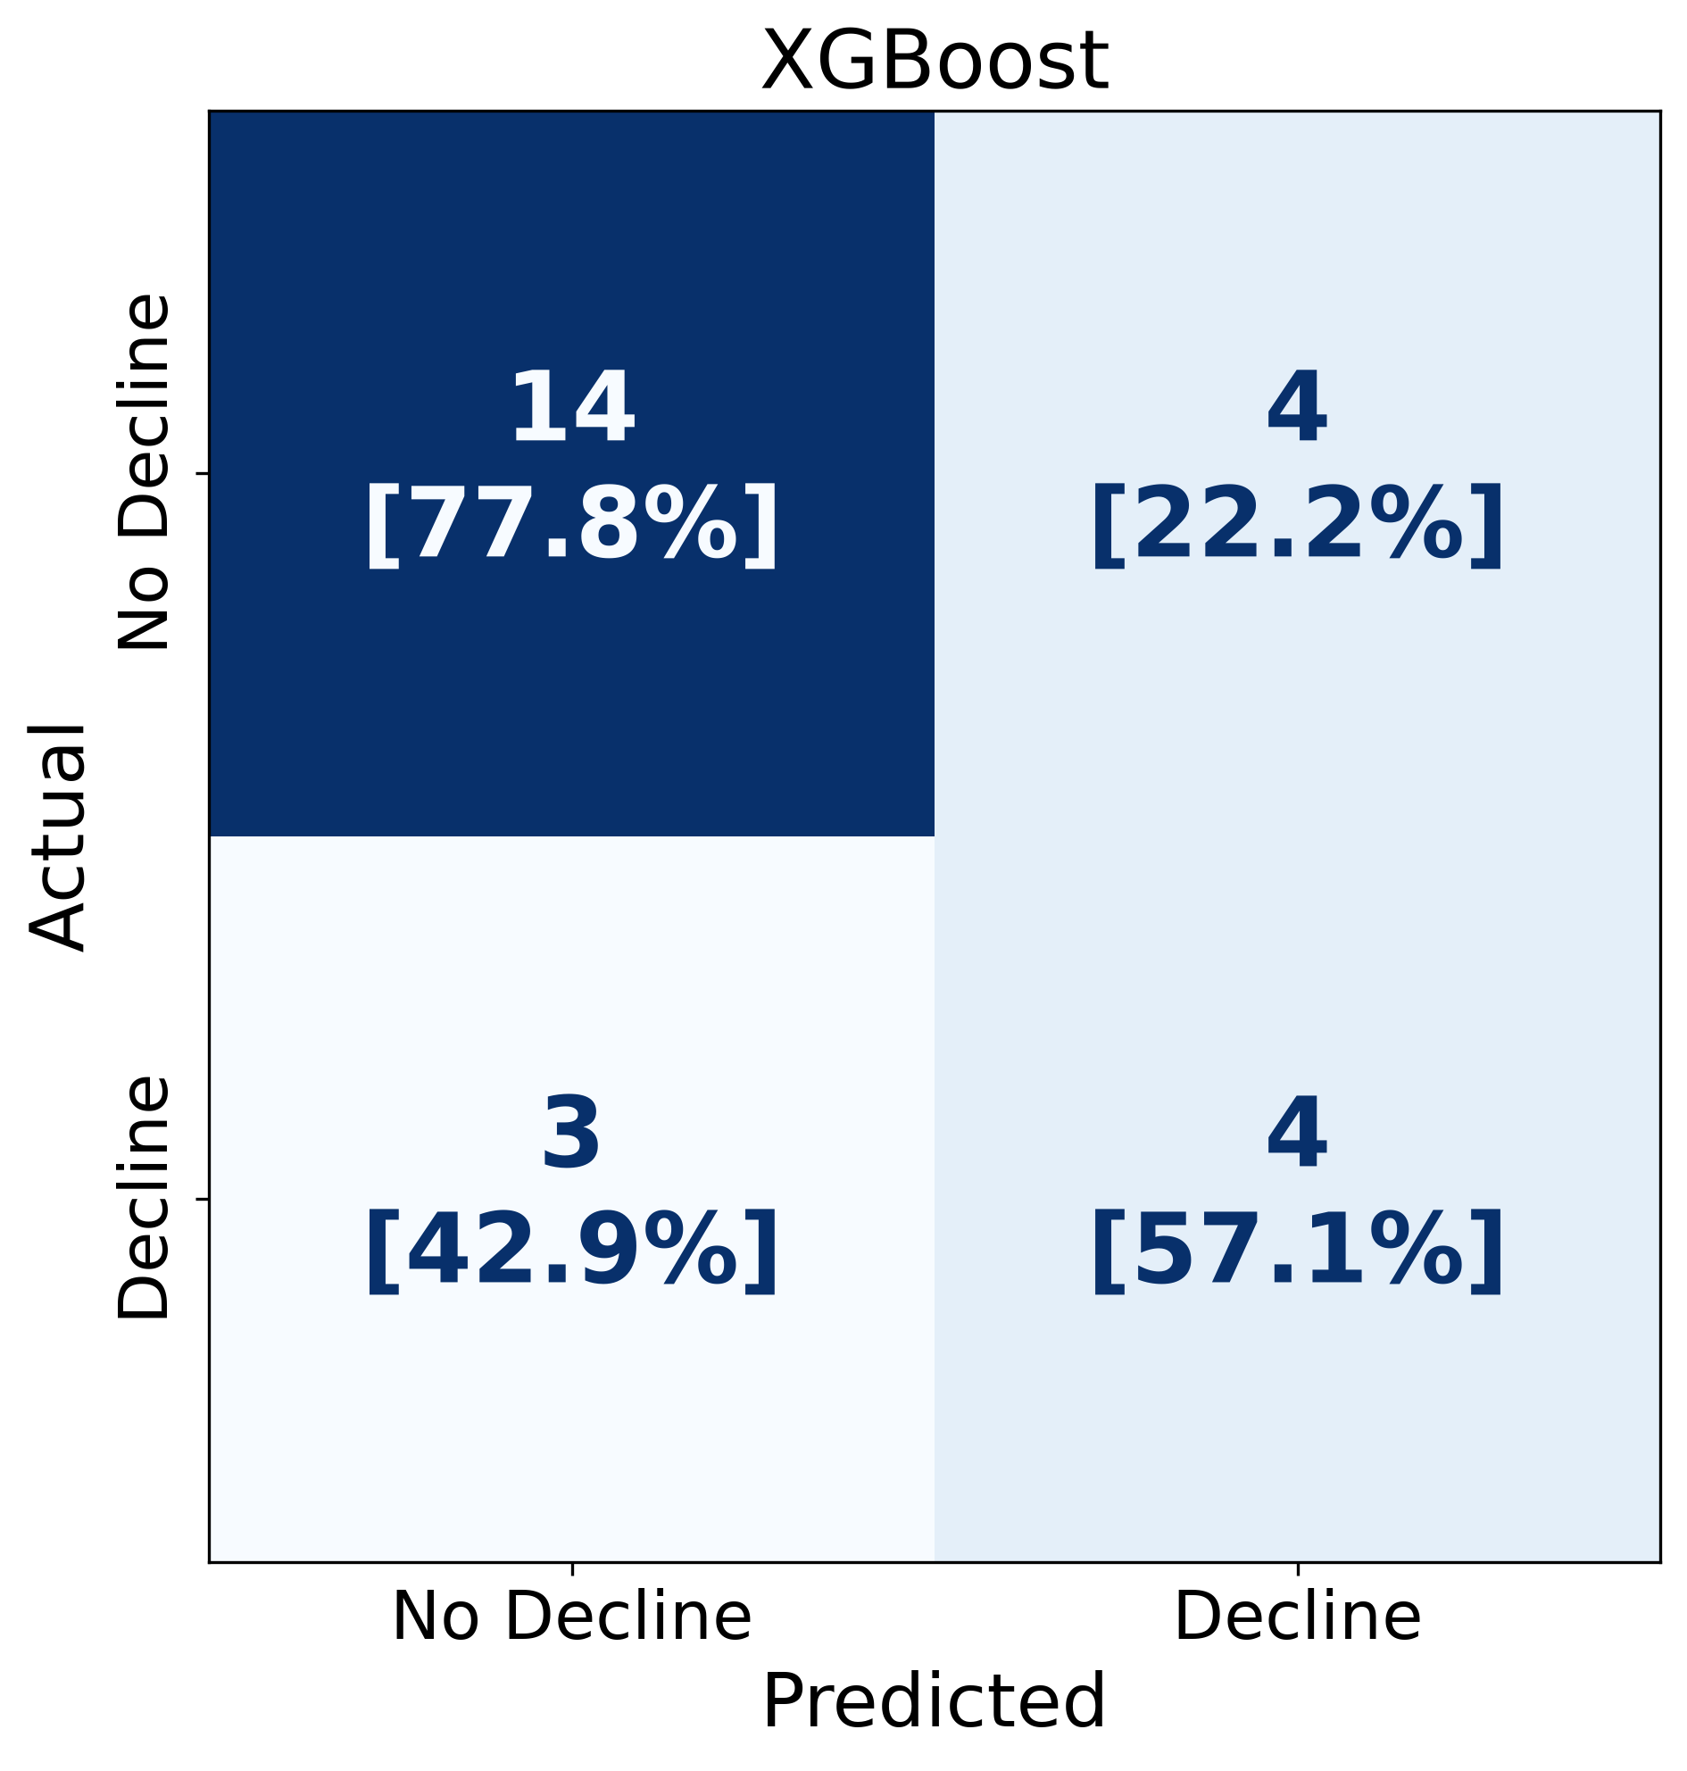

Confusion Matrices
Across Models
Overall Group (N=106)
Best model is TPOT(Extra Trees) in the middle
CN Baseline Group (N=25)
MCI Baseline Group (N=81)

Slide 26
Confusion Matrix – Overall Group (N = 106)
Model | TN | FP | FN | TP | Accuracy | Precision | Recall | F1
Random Forest | 61 | 10 | 15 | 20 | 0.764 | 0.667 | 0.571 | 0.615
TPOT (Extra Trees) | 62 | 9 | 10 | 25 | 0.821 | 0.735 | 0.714 | 0.725
XGBoost | 54 | 17 | 11 | 24 | 0.736 | 0.585 | 0.686 | 0.632

Slide 27
Confusion Matrix – CN Baseline (N = 25) (CN-CN & CN-MCI)
Model | TN | FP | FN | TP | Accuracy | Precision | Recall | F1
Random Forest | 17 | 1 | 6 | 1 | 0.720 | 0.500 | 0.143 | 0.222
TPOT (Extra Trees) | 17 | 1 | 3 | 4 | 0.840 | 0.800 | 0.571 | 0.667
XGBoost | 14 | 4 | 3 | 4 | 0.720 | 0.500 | 0.571 | 0.533

Slide 28
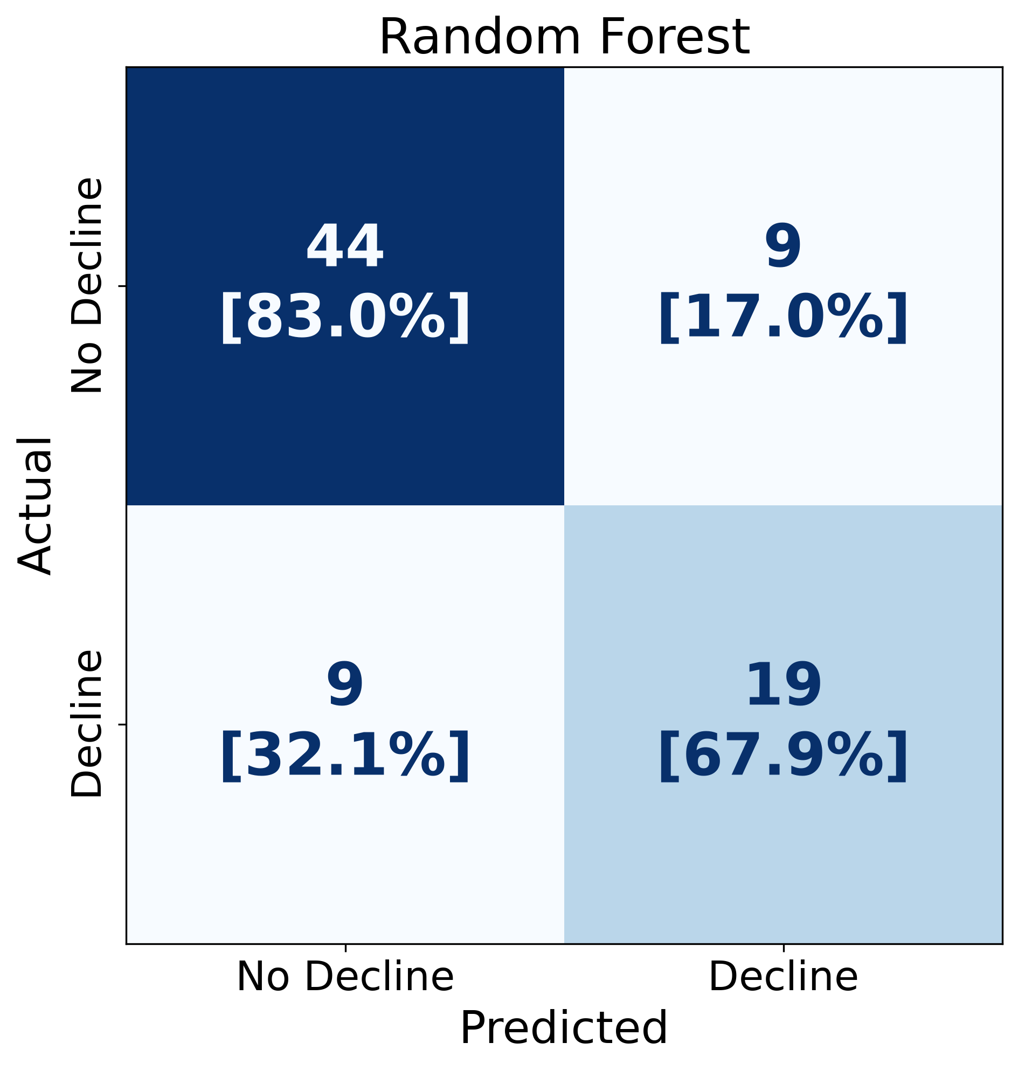
Confusion Matrix – MCI Baseline (N = 81) (MCI-MCI & MCI-AD)
Model | TN | FP | FN | TP | Accuracy | Precision | Recall | F1
Random Forest | 44 | 9 | 9 | 19 | 0.778 | 0.679 | 0.679 | 0.679
TPOT (Extra Trees) | 45 | 8 | 7 | 21 | 0.815 | 0.724 | 0.750 | 0.737
XGBoost | 40 | 13 | 8 | 20 | 0.741 | 0.606 | 0.714 | 0.656

